Slide 1
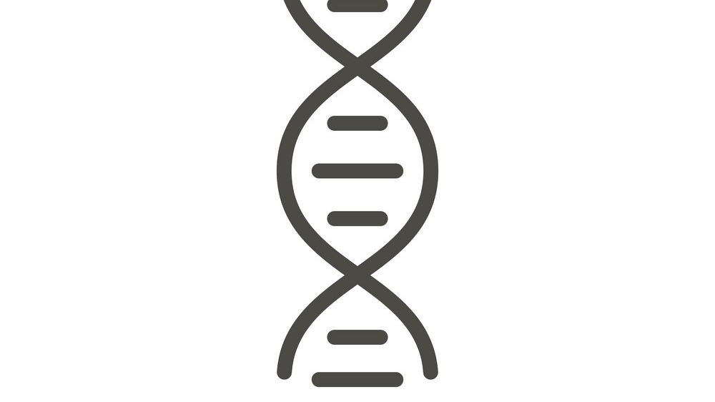
Prediction of genetic disorder before birth
Arya S

Slide 2


Business problem
Approximately 3-5% childern born every year have some genetic disorder
Currently the test available are invasive and detect only a few common disorders
There are many serious disorders which cause shortened life expectancy or the babies die before being born

Slide 3
Solution
Based on certain factors, predict the chances of the baby being born with genetic disorder

Slide 4
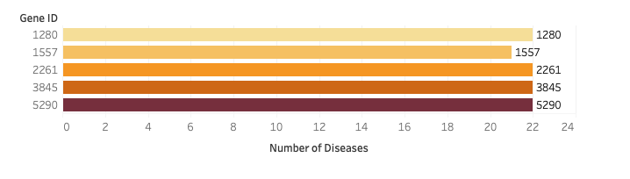
Genes to look out for

Slide 6
Disease Specificity Index
There are genes (or variants) that are associated wiht multiple diseases (e.g. TNF) while others are associated with a small set of diseases or even to a single disease. The Disease Specificity Index (DSI) is a measure of this property of the genes (and variants). It reflects if a gene (or variant) is associated to several or fewer diseases. It is computed according to:
where:
- N d is the number of diseases associated to the gene/variant - N T is the total number of diseases in DisGeNET
The DSI ranges from 0.25 to 1. Example: TNF, associated to more than 1,500 diseases, has a DSI of 0.263, while HCN2 is associated to one disease, with a DSI of 1.
If the DSI is empty, it implies that the gene/variant is associated only to phenotypes.

Slide 7
Disease Pleiotropy Index
The rationale is similar than for the DSI, but we consider if the multiple diseases associated to the gene (or variant) are similar among them (belong to the same MeSH disease class, e.g. Cardiovascular Diseases) or are completely different diseases and belong to different disease classes. The Disease Pleiotropy Index (DPI) is computed according to
where:- N _{dc} is the number of the different MeSH disease classes of the diseases associated to the gene/variant - N _{TC} is the total number of MeSH diseases classes in DisGeNET (29)
The DPI ranges from 0 to 1. Example: gene KCNT1 is associated to 39 diseases, 4 disease groups, and 18 phenotypes. 29 out of the 39 diseases have a MeSH disease class. The 29 diseases are associated to 5 different MeSH classes. The DPI index for KCNT1 = 5/29 ~ 0.172. Nevertheless, gene APOE, associated to more than 700 diseases of 27 disease classes has a DPI of 0.931.
If the gene/variant has no DPI value, it implies that the gene/variant is associated only to phenotypes, or that the associated diseases do not map to any MeSH classes.

Slide 8
